Slide 1
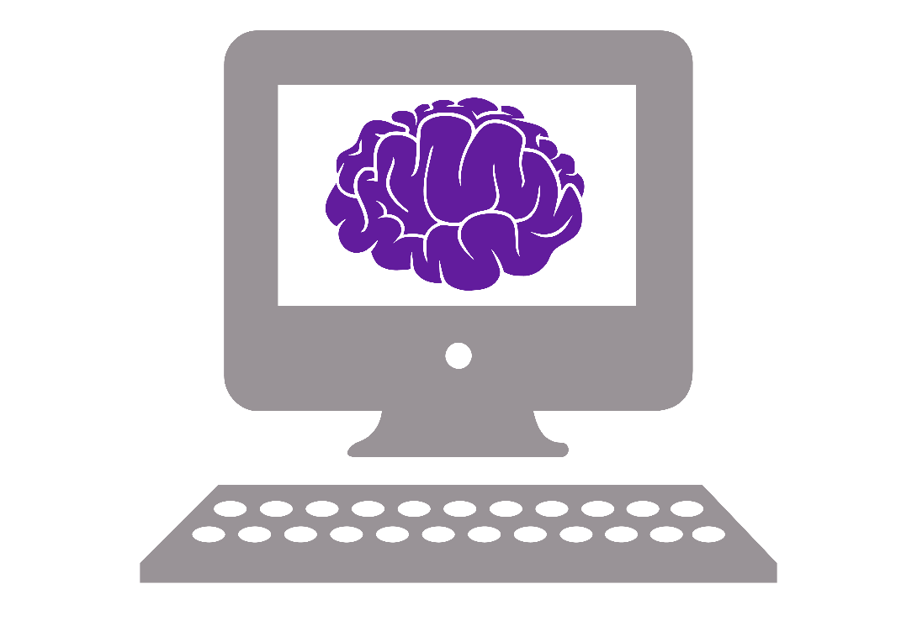
Sussex Neuroscience Python Course

Slide 2
What you will (hopefully) come away with
Basic understanding of Python
Use Python to make graphs
Know how to use Python to analyse your own data
Know how to look for help

Slide 3
However…
You can only learn how to code by doing!
Exercises during/after every session to help you gain experience
This course is not a magic coding potion

Slide 4
Course program
Session 1 (13 January)
13:00 – 14:00 Introduction to computer science
14:00 – 16:00 Introduction to Python
Session 2 (16 January)
13:00 – 15:15 Introduction to modules and Numpy
15:15 – 16:00 Data analysis in Python
Session 3 (20 January)
13:00 – 15:00 Introduction to data visualization with Matplotlib
15:00 – 16:00 Good coding practices
Session 4 (23 January)
13:00 – 14:00 Discuss good coding practices exercise + general questions
14:00 – 16:00 Python project work

Slide 5
Structure of each part
Lecture (sometimes) – slides with information
Live coding – Jupyter Notebook with code and explanations
Exercises – Apply what you just learned in an exercise
Pair programming during the session
Take home the exercises

Slide 6
Pair programming
Pair up in twos
One person actively typing (driver)
Other person gives input and checks code (navigator)
Switch frequently

Slide 7
During the course
If you need to step out at any time, please do so
Ask questions any time
Be constructive when helping each other
Coffee and tea in the back
Water fountain just outside
Toilets outside the door to the right, follow signs

Slide 8
Before we begin…
Why are you learning Python?
Use for research
Improve chances of a job
For fun
Other reason
Can you code in another language?
Yes, MATLAB
Yes, R
Yes, other…
No

